Slide 1
Distributed Energy Resources and Resiliency: A State Perspective
Kyle Haas
Energy Policy Manager
Maryland Energy Administration

Slide 2
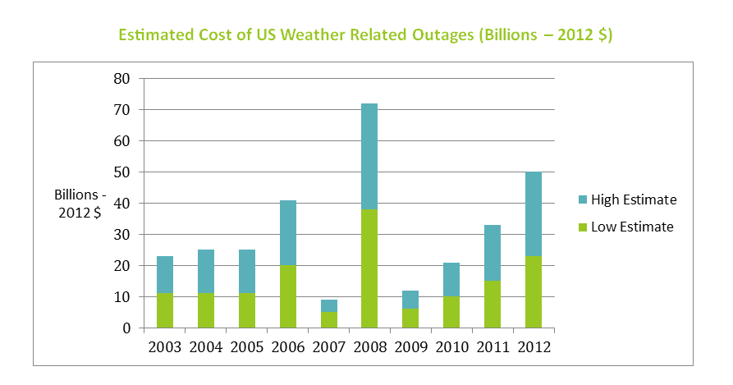
The Cost of Extreme Weather
Source: http://energy.gov/sites/prod/files/2013/08/f2/Grid%20Resiliency%20Report_FINAL.pdf
Notes:
Presidents Council of Economic Advisers: Electricity outages cost the US economy over $336 billion dollars between 2003 and 2012
Challenge: Monetize this externality

Slide 3
How We Look at Microgrids
Clean DG
Carbon emissions (RE, CHP, etc.)
Blue-sky economical
Consumer empowerment
Leveraging of public dollars
Dispatchable?
System Controls
Building IQ
Enables PJM market participation
Building automation
Engages, educates
Microgrid as a grid asset
Storage
Power storage?
Thermal storage
Ancillary services
Frequency reg.
Notes:
If we break down the pieces of a microgrid, its easier to understand their capabilities, strengths, and weaknesses.
We can also help to develop the each industry and encourage entrepreneurs to bring related technology together, which decreases costs.

Slide 4
Strategies for Deployment of DER
Lower cost/barriers to Distributed Energy Resources
Fairly compensate DER for next generation of energy service (stackable benefits)
Safely and affordably integrate DER into the grid

Slide 5
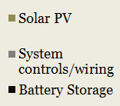
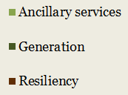
Attacking Cost with Stackable Benefits
?
?

Slide 6
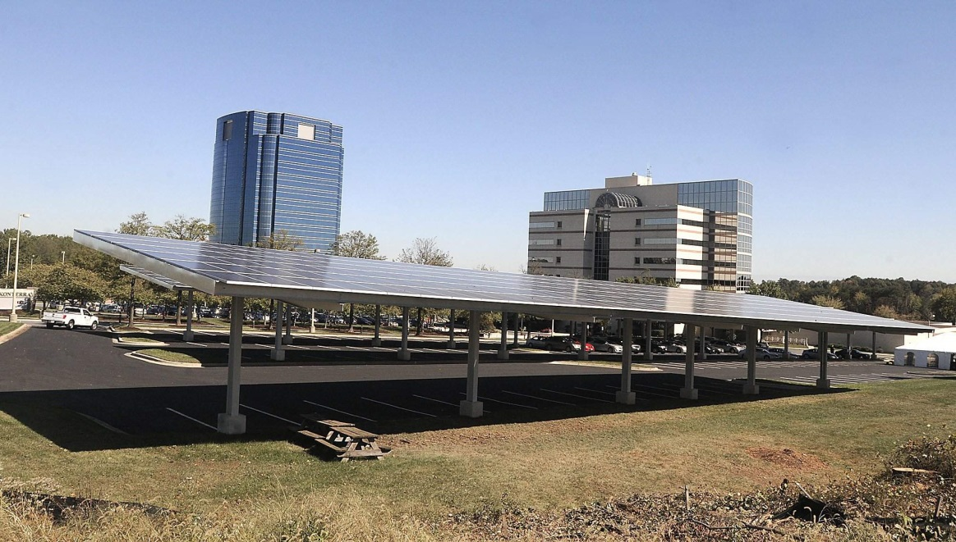
Konterra Microgrid
What do you think the Value Stack looks like?

Slide 7
FDA: 55 MW Microgrid
What do you think the Value Stack looks like?
Notes:
5.8 MW dual fuel engine
Four 4.5 MW turbine-generators
One 2MW standby diesel generator
30 kw PV array
Two 7.5 MW dual fuel turbine generator
One 5 MW steam turbine generator
Two 2.25 MW diesel black-start generator

Slide 8
Resiliency Through Microgrids Task Force
Evaluate the current intercon. process with the PSC
Tariff study to examine the value of DG on the grid
Work with utilities to incorporate microgrids into the planning process
Educate interested local governments on microgrids
Development of incentives to further microgrid technologies
Advanced System Controls
Energy Storage
Microgrid Grants

Slide 9
Demand Response and Building Automation Grants
Innovative and novel building energy management systems;
Building automation;
Cooperative DSR projects between multiple parties on a common piece of distribution infrastructure;
Building intelligence and predicative energy optimization systems;
Micro-aggregation projects that control multiple small and distributed loads;
Demand management solutions to minimize peak demand charges;
Microgrids that can participate in PJM demand response markets or utility programs;
Distributed energy resources used for participating in demand response markets.

Slide 10
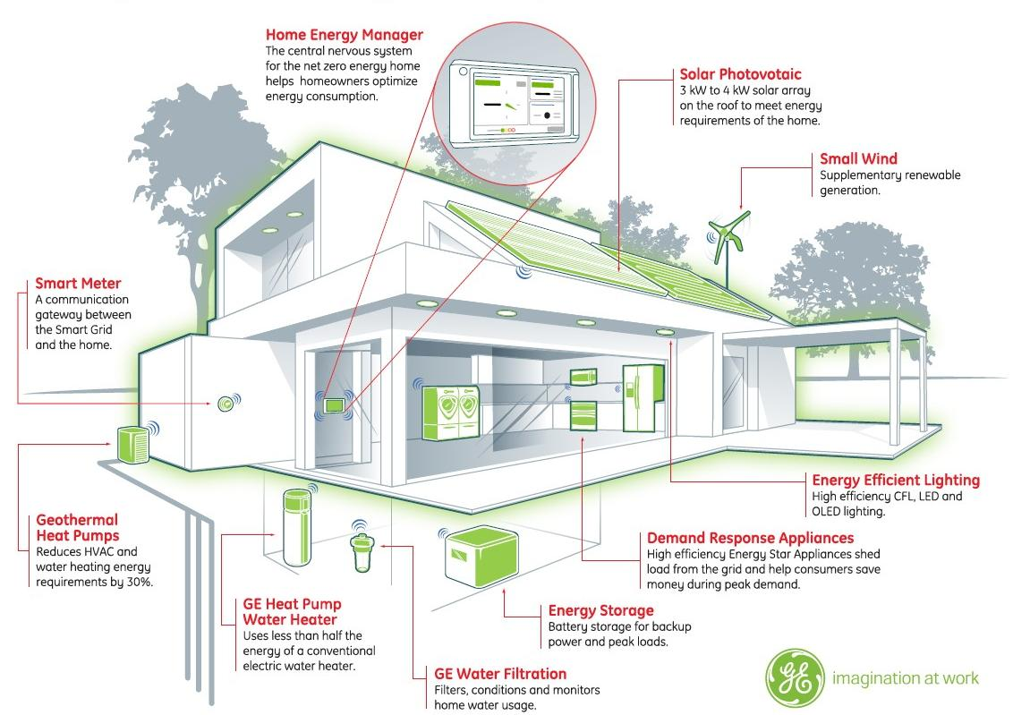
Demand Response and Building Automation Grants

Slide 11
Long term: Stacking More Benefits
Defferal
DR

Slide 12
Thank you!
Contact Info:
Kyle Haas
Energy Policy Manager, MEA
(410) 260-7523

